Slide 1
10/5/2022
Today’s lecture and exercise are intended to help you achieve the following learning objective: Perform a molecular docking calculation and visualize the results. Explain the limitations of molecular docking.
Introduction to Molecular Docking
AutoDock Vina
Exercise 5: Molecular Docking with AutoDock Vina (lunch period)

Slide 2
Introduction to Molecular Docking
At the end of this lecture, you should be able to address these questions:
What is molecular docking?
What is it good for?
How does it work?
What are its key approximations?

Slide 3
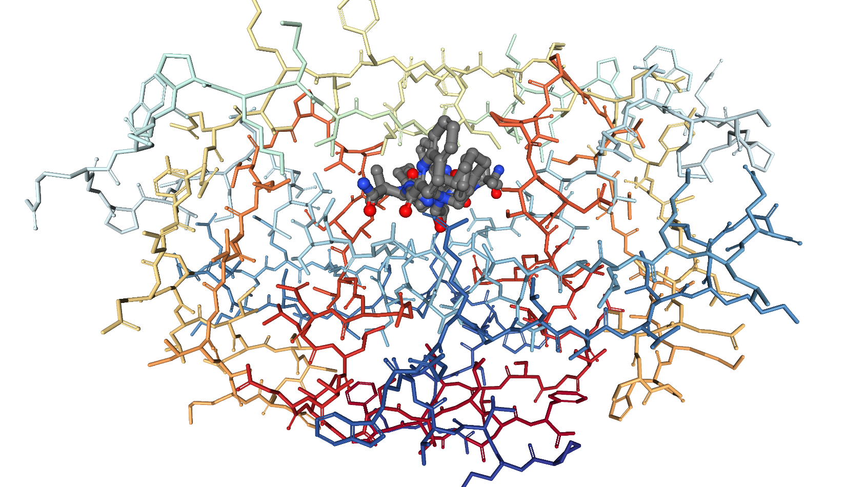
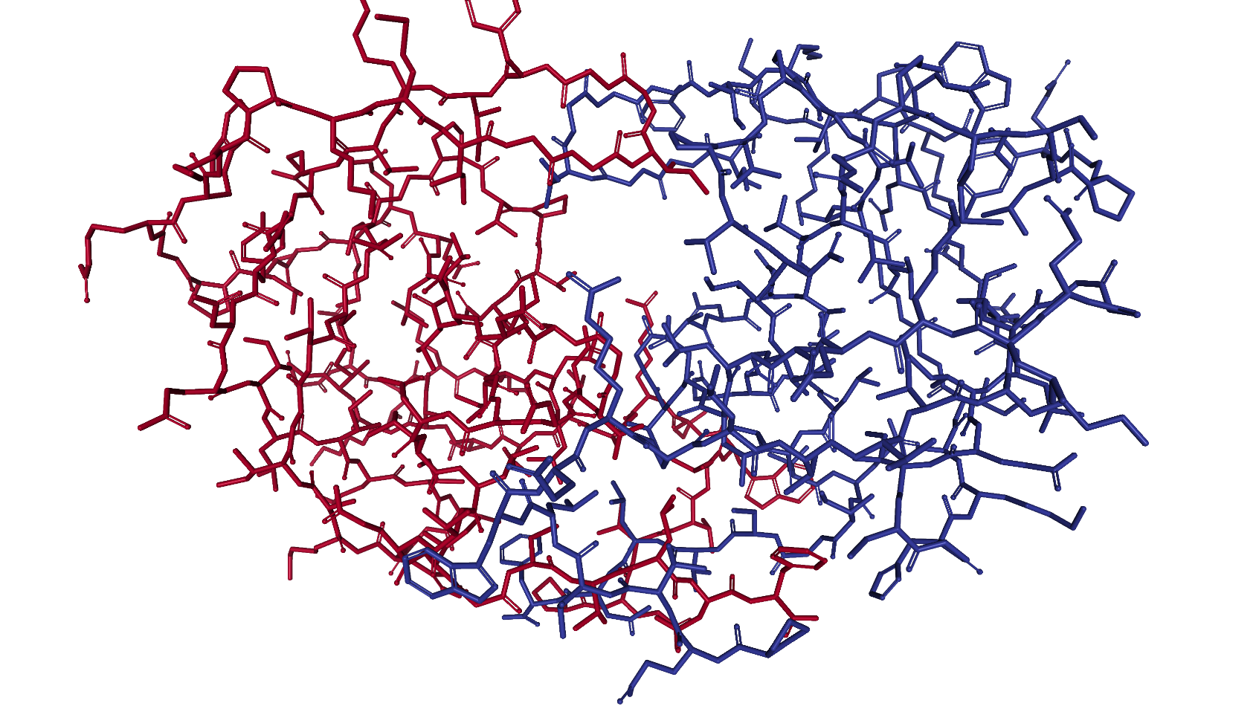
What is molecular docking?
To predict
the 3D structure of a noncovalent complex
protein-ligand
protein-protein
the binding affinity of the partners (scoring)
Prior to prediction, structure of binding partner(s) may be known, but
could be affected by binding
may be bound to different partners

Slide 4


What is molecular docking good for?
Predicted structure can
explain behavior, e.g. mutagenesis
facilitate molecular design, e.g. of pharmaceuticals
Predicted scores can be used for virtual screening

Slide 5
How does docking work?
Docking is optimization of a scoring function, E(x)
E can be the total potential energy or interaction energy
can be entirely physics-based or partly knowledge-based
physics-based are usually molecular mechanics energies
x is a vector describing the molecular coordinates
Optimization algorithms include
anchor-and-grow in UCSF DOCK, the original docking program
genetic algorithm in AutoDock, the most popular docking program
Fast fourier transform, especially for fragment and protein-protein docking

Slide 6
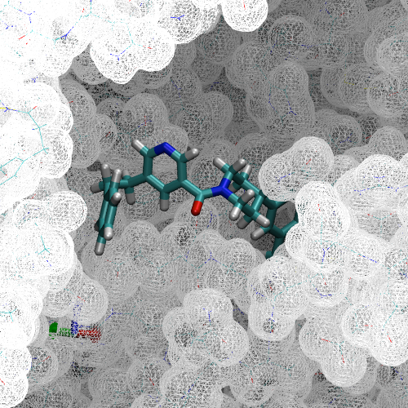
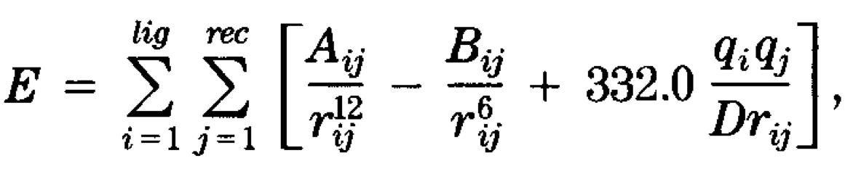
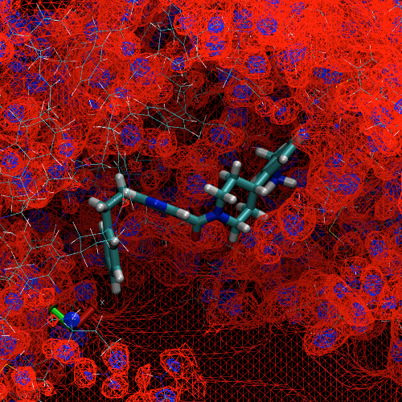
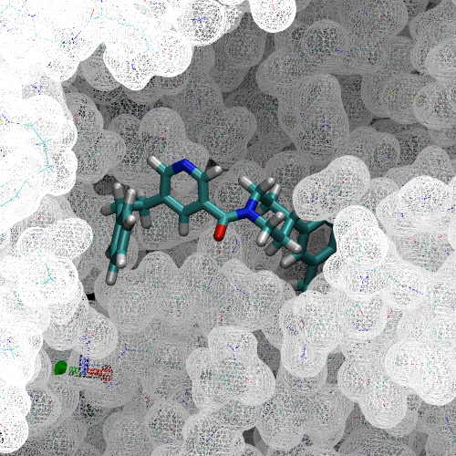
Scoring is based on molecular mechanics
From Figure 3 of
Durant and McCammon, 2011
Nonbonded interactions are often
interpolated from precomputed grids
AMBER interaction energies
LJ repulsive
[Meng, Shoichet, and Kuntz, 1992]
Electrostatic
LJ attractive

Slide 7

E(x) is often rugged, requiring special optimization
This principle can be understood considering climbing a mountain peak. For minimization, flip everything upside down.
https://pixabay.com/photos/mountains-landscape-snow-nature-1622731/

Slide 8
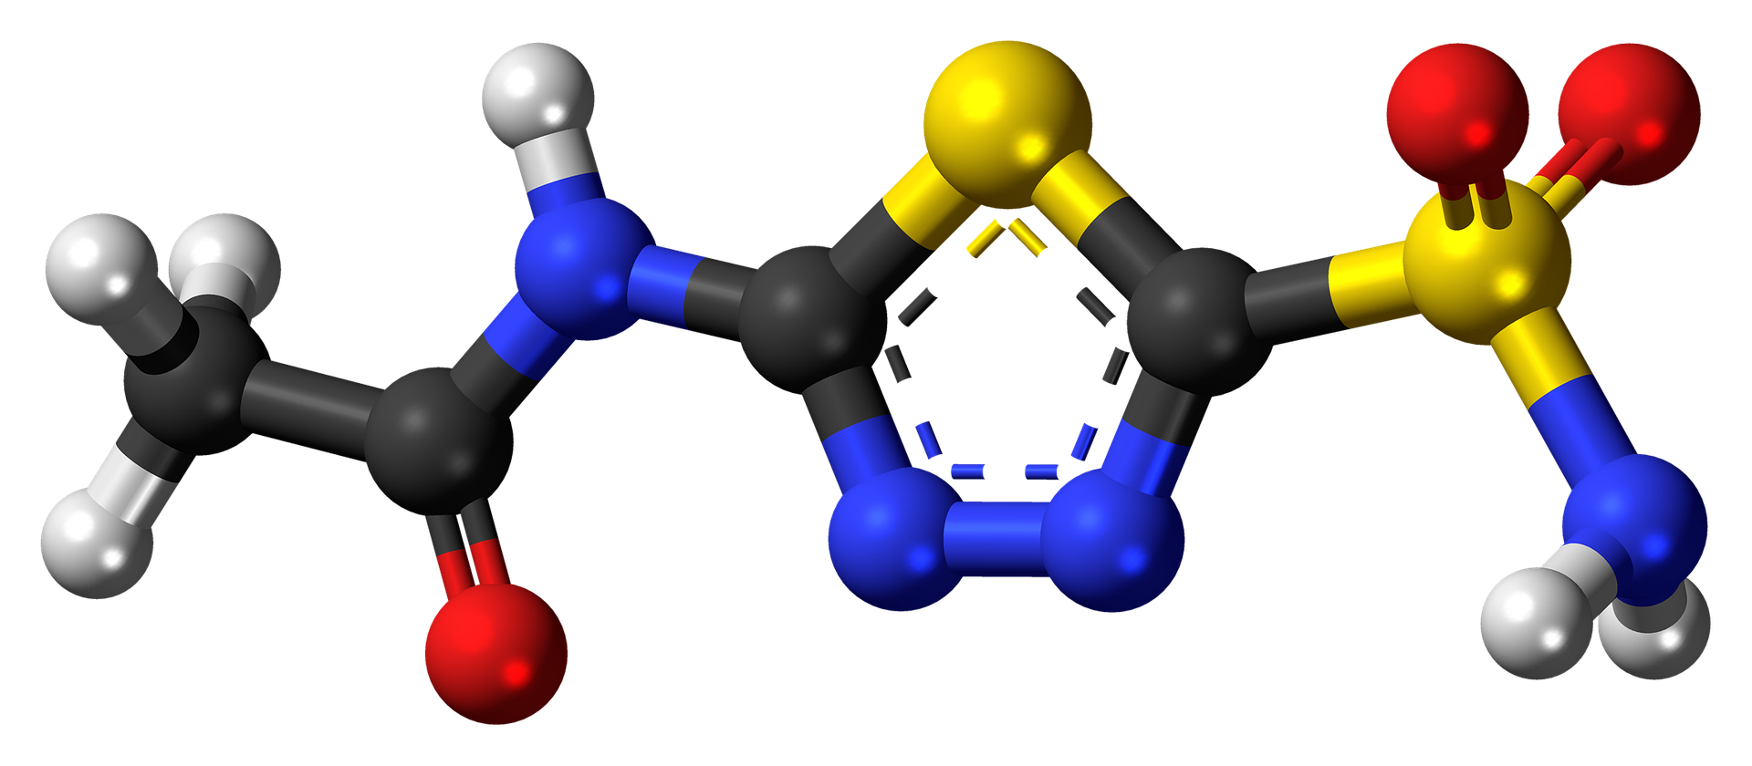
UCSF DOCK is based on anchor-and-grow
Receptor spheres and rigid “anchor” in ligand
represented as graph of atoms separated by distances
docking is search for isomorphic subgraph
Until the molecule is complete, segments are iteratively
added to the anchor and
pruned if the energy is too high
Complete structures are locally minimized
Segment
Anchor

Slide 9
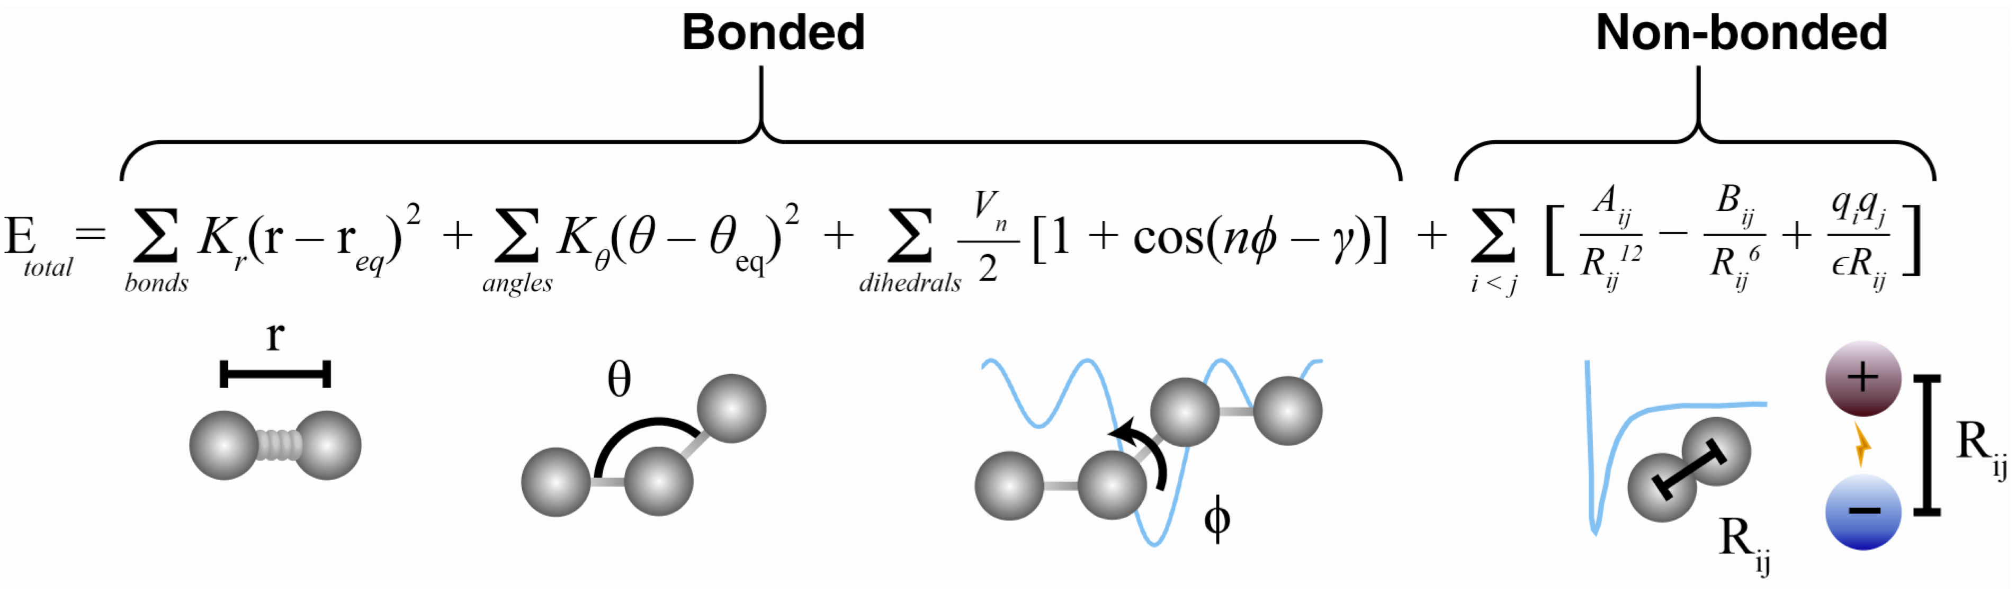
AutoDock uses a genetic algorithm
Population of structures
represented by torsions. bond length and angles assumed constant.
evolve over generations
Generations iterate
mapping & fitness evaluation. mapping x and calculating E(x).
selection. fitter individuals reproduce more.
crossover. torsions swapped between individuals. enable global search.
mutation. small changes to individuals. permit local search.

Slide 10
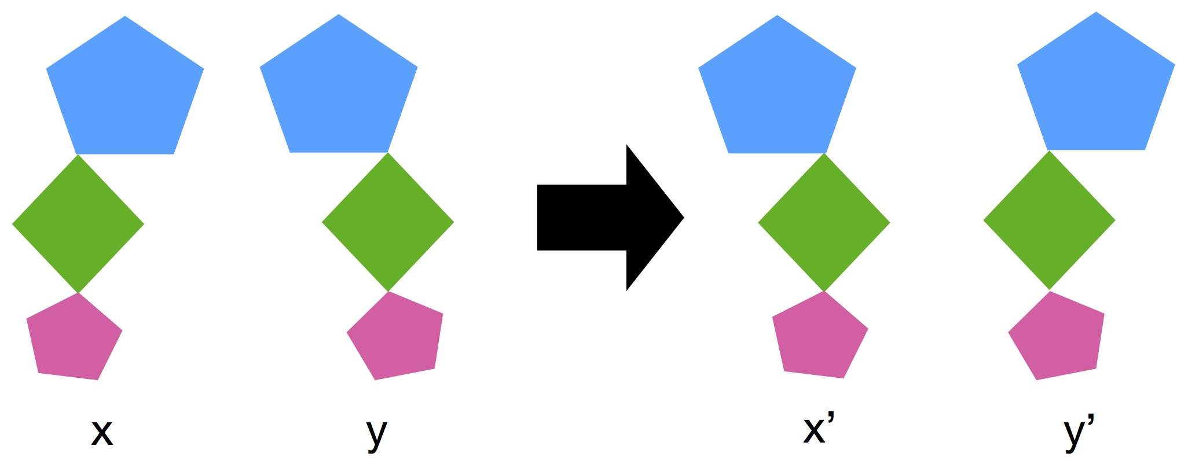
Crossover

Slide 11
FFT is common in docking
Both molecules are represented by a 3D grid
FFT correlation calculation
gives scores as molecules are translated relative to one another
is much faster than direct calculation
Scores can be based on
shape complementarity [Katchalski-Katir et al, 1991]
van der Waals and electrostatics
Strategy makes most sense for rigid binding

Slide 12

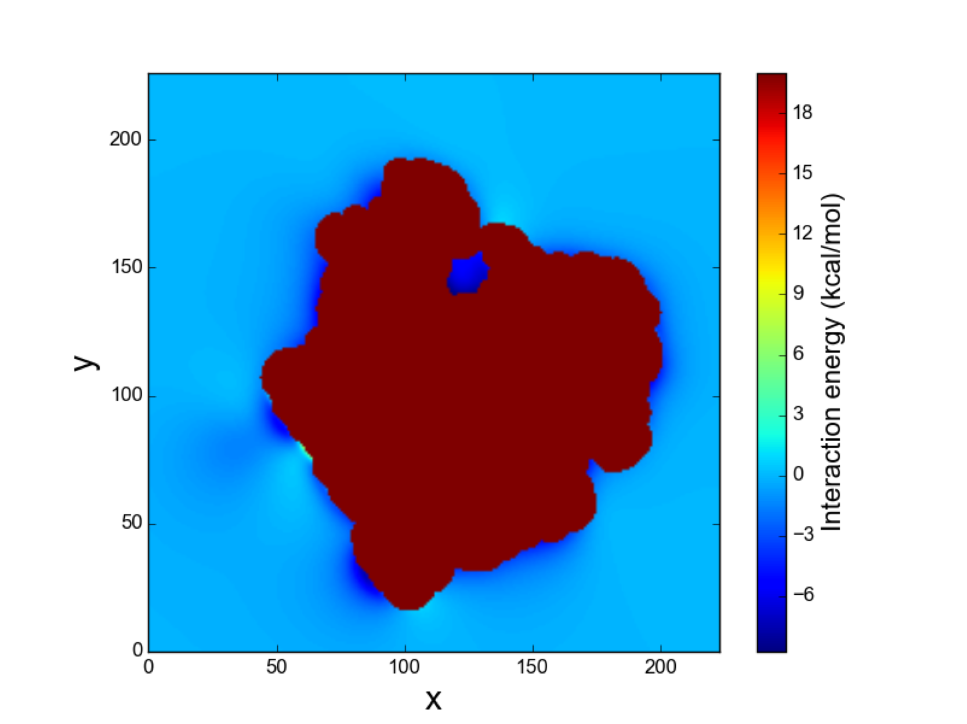
FFT can also be used to estimate binding ΔG
2D cross section of the interaction energy
[Nguyen, Zhou, and Minh, 2018]

Slide 13
How well does docking work?
How well does it work?
Fairly successful at generating binding poses [Damm-Ganamet et al, 2013]. Usually successful (~80%) at ranking them.
Poorly correlated with binding free energies [Warren et al, 2006].
Unreliable at separating actives from decoys [Cross et al, 2009].
Sometimes successful at virtual screening. Hit rates < 20%.

Slide 14
How can it get better?
How can it be better?
Free energy includes both enthalpy and entropy. Docking scores usually exclude entropy.
Water often mediates protein-ligand interactions. Docking usually does not consider it.
Polarizability. Ligands can adapt to the protein environment. Docking usually does not consider this.

Slide 15
Review
What is molecular docking?
What is it good for?
How does it work?
What are its key approximations?

Slide 16
References
Cross, J. B.; Thompson, D. C.; Rai, B. K.; Baber, J. C.; Fan, K. Y.; Hu, Y.; Humblet, C. Comparison of Several Molecular Docking Programs: Pose Prediction and Virtual Screening Accuracy. Journal of Chemical Information and Modeling 2009, 49 (6), 1455–1474. https://doi.org/10.1021/ci900056c.
Damm-Ganamet, K. L.; Smith, R. D.; Dunbar, J. B.; Stuckey, J. A.; Carlson, H. A. CSAR Benchmark Exercise 2011-2012: Evaluation of Results from Docking and Relative Ranking of Blinded Congeneric Series. Journal of Chemical Information and Modeling 2013, 53 (8), 1853–1870. https://doi.org/10.1021/ci400025f.
Durrant, J. D.; McCammon, J. A. Molecular Dynamics Simulations and Drug Discovery. BMC Biol 2011, 9 (1), 71. https://doi.org/10.1186/1741-7007-9-71, adapted under the CC BY 2.0 license.
Katchalski-Katzir, E.; Shariv, I.; Eisenstein, M.; Friesem, A. a; Aflalo, C.; Vakser, I. a. Molecular Surface Recognition: Determination of Geometric Fit between Proteins and Their Ligands by Correlation Techniques. Proceedings of the National Academy of Sciences of the United States of America 1992, 89 (6), 2195–2199. https://doi.org/10.1073/pnas.89.6.2195.
Meng, E. C.; Shoichet, B. K.; Kuntz, I. D. Automated Docking with Grid-Based Energy Evaluation. Journal of Computational Chemistry 1992, 13 (4), 505–524.
Nguyen, T. H.; Zhou, H.-X.; Minh, D. D. L. Using the Fast Fourier Transform in Binding Free Energy Calculations. Journal of Computational Chemistry 2018, 39, 621–636. https://doi.org/10.1002/jcc.25139.
Warren, G. L.; Andrews, C. V. W.; Capelli, A.-M.; Clarke, B.; LaLonde, J.; Lambert, M. H.; Lindvall, M.; Nevins, N.; Semus, S. F.; Senger, S.; et al. A Critical Assessment of Docking Programs and Scoring Functions. Journal of Medicinal Chemistry 2006, 49 (20), 5912–5931. https://doi.org/10.1021/jm050362n.

Slide 17
AutoDock Vina
This module will be a tutorial on AutoDock Vina
docking program developed at The Scripps Research Institute
http://vina.scripps.edu
After this module, you should be able to set up and run a molecular docking calculation using AutoDock Tools and AutoDock Vina

Slide 18
Why AutoDock Vina?
There are many molecular docking programs
Why AutoDock Vina?
Free
Works on multiple platforms
Fast
Very popular
>10,000 citations of primary reference [Trott and Olson, 2010]
>1,400 citations to primary reference of AutoDock 3 & 4 [Morris et al, 1998]
Available on PSC bridges and other NSF supercomputers

Slide 19
Comparison of AutoDock Versions
AutoDock 4 | AutoDock Vina
 | 2 orders of magnitude faster. Parallelized code.
Lennard-Jones sterics | Gaussian sterics
Lamarkian genetic algorithm | Gradient-based optimizer
Pre-calculated grid maps | On-the-fly grid maps
Average time per receptor-ligand pair on the test set. “AutoDock” refers to AutoDock 4, and “Vina” to AutoDock Vina 1.

Slide 20
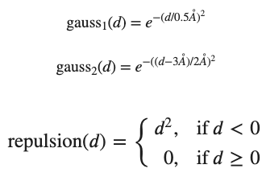
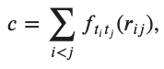
The Vina Scoring Function
General form of terms is , a summation over all pairs of atoms that can move relative to each other
Steric terms are the sum of two Gaussians and a repulsion,
Hydrophobic and H-bond terms are linear interpolations

Slide 21
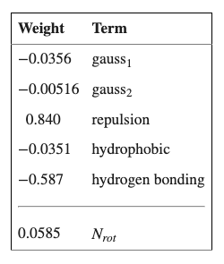
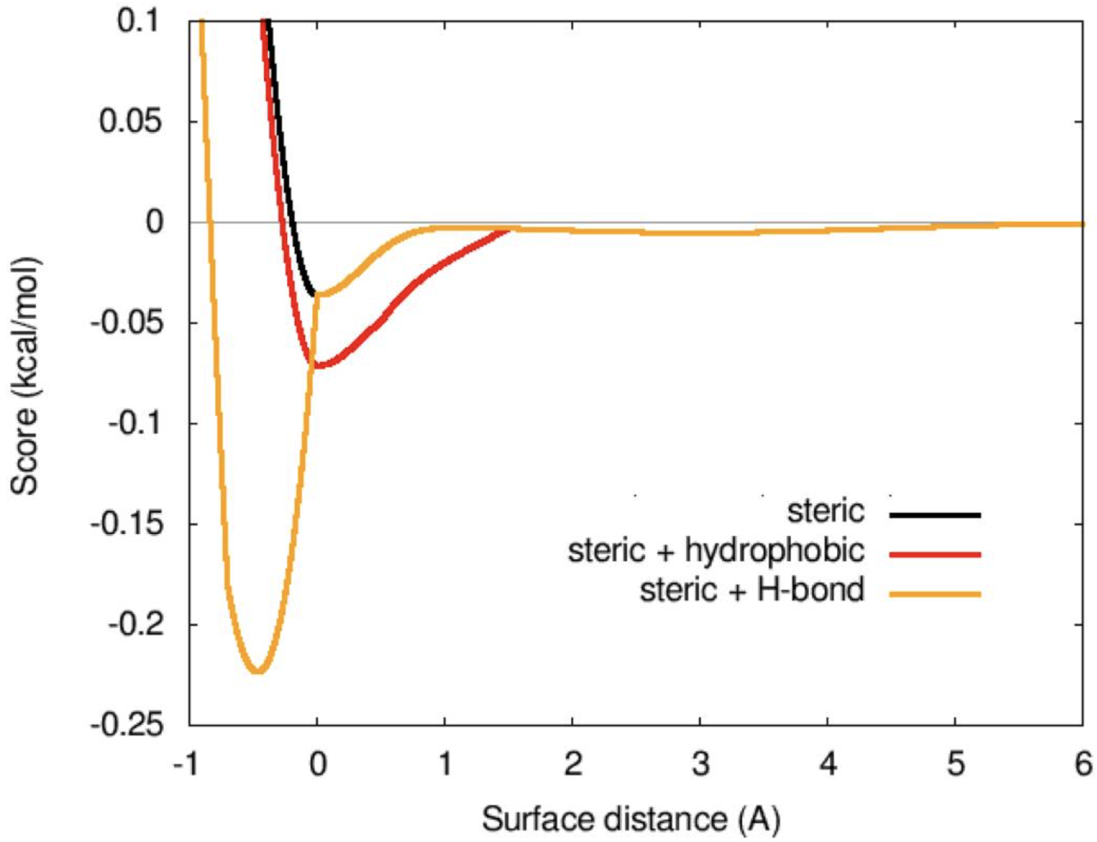
The Vina Scoring Function

Slide 22
References
Morris, G. M.; Goodsell, D. S.; Halliday, R. S.; Huey, R.; Hart, W. E.; Belew, R. K.; Olson, A. J. Automated Docking Using a Lamarckian Genetic Algorithm and an Empirical Binding Free Energy Function. Journal of Computational Chemistry 1998, 19 (14), 1639–1662.
Trott, O.; Olson, A. J. AutoDock Vina: Improving the Speed and Accuracy of Docking with a New Scoring Function, Efficient Optimization and Multithreading. Journal of Computational Chemistry 2010, 31 (2), 455–461.

Slide 23
Exercise 5: Molecular Docking with AutoDock Vina (lunch period)
colab

